Slide 1
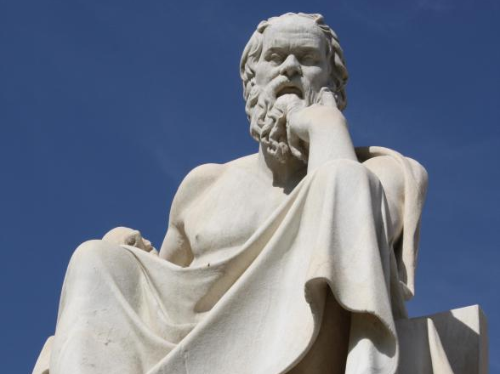
By participating in
Socratic Seminar
Scholars will practice academic behavior and language that
will be expected in a 21st century classroom & worksplace.

Slide 2
Socratic Seminar
UNIVERSAL CONCEPT:
JUSTICE
Texts:
“The Lowest Animal” by Mark Twain
Your notes on Realism
OBJECTIVES:
1.) Students will explore the universal concept of the JUSTICE as it is exhibited in Twain’s satirical essay “The Lowest Animal”
2.) Gain a deeper understanding of how REALIST thought shaped American views by the Socratic Seminar Preparation Guide which includes focus questions and annotations of the text.

Slide 3
Warm Up Reflection:
TOPIC: Based on Mark Twain’s satirical essay, “The Lowest Animal,” what hinders humans’ pursuit of JUSTICE?
INTRODUCE EVIDENCE: Do you dis/agree with Twain’s ironic hypothesis? Why or why not?
EVIDENCE: Provide examples and evidence from experiences and/or the text to support your evaluation.
ANALYSIS: Explain the example/evidence proves your point of view.
COMMENTARY: Despite the obvious humorous tone, what message or caution does Twain’s “The Lowest Animal” provide for contemporary America?

Slide 4
The Socratic Seminar and Academic Behavior
Socratic Seminar is a method of teaching developed by Socrates. He engaged his students in intellectual discussion by responding to questions with questions, instead of answers. This method encouraged the students to think for themselves rather than being told what to think.
By participating in a Socratic Seminar you will practice academic behavior that will be expected in college and/or the workplace environment. This behavior includes: LISTENING, ASKING, AND DISCUSSING
You Show Academic Behavior By:
a. Participating when it is your turn to speak.
b. Expressing yourself clearly in sophisticated language.
c. Respecting others by avoiding side conversation and rude behaviors such as negative body language.
d. Speaking when it only when it is your turn and not interrupting or cutting someone off.
e. Making logical comments that are related to the text and purpose being discussed.

Slide 5
Part 1: Generate Questions Using Academic Terms
TERMS
theme
Claim
IDEAS
Human Nature
Power of persuasion
THINKERS
MARK TWAIN
purpose
Evidence
Genre
Satire
Rhetorical triangle
Persuasion
Ethos
Pathos
Logos
Realism
Equality
Freedom
individuality
Irony
Hyperbole
Understatement
Narrator
Point of View
American Identity
Justice
Regionalism
Abolitionism
Human Rights

Slide 6
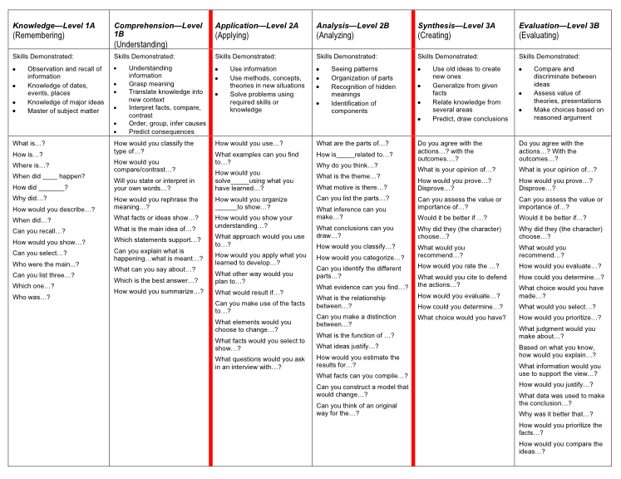

Slide 7
Sentence Frames to use as needed
To state an opinion
I believe ____ because…
I agree/disagree because…
I understand your point that ____; however,_____.
Although I agree with ___, I also believe that …
To ask a question
I am confused about …
Can someone explain…
I have questions about…
What does it mean when __says…?
When you__do you mean…?
To explain/elaborate
I’d also like to add that…
Evidence such as ____ suggests…
When ___, it is clear that…
Perhaps ___ can be interpreted as …
Another way to look at ____ is …

