Slide 1
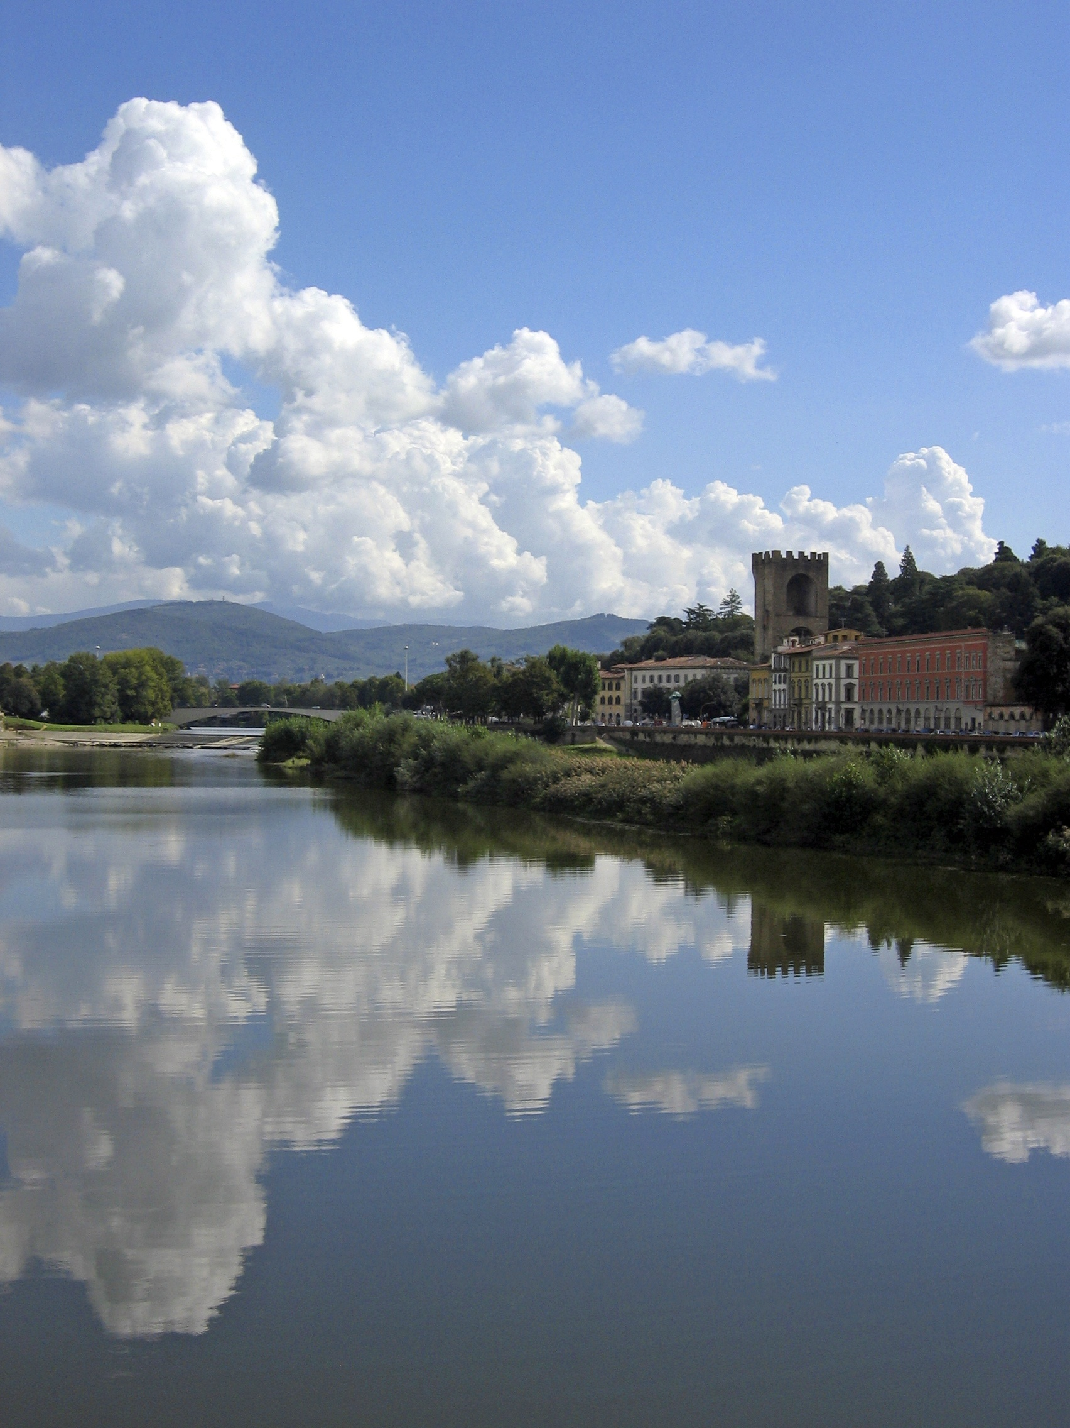
Romeo and Juliet
Review Game

Slide 2
Question 1
The reason that the feud between the families has gone on so long is because of
A. legal action
B. a land dispute
C. family pride
D. a trade rivalry

Slide 3
Oops!
Sorry, try again!

Slide 4
CORRECT!
Good job.
You may continue….

Slide 5
Question 2
The reason that Romeo is upset at the start of the play is because
A. Juliet won’t accept his advances
B. He is in love with a coldly virtuous maiden
C. Rosaline was the daughter of his enemy
D. Mercutio started a nasty rumor about him

Slide 6
Wrong answer!
Go back and try again.

Slide 7
Well done!
You may continue….

Slide 8
Question 3
Romeo’s first love was
A. Juliet
B. Queen Elizabeth
C. The Nurse
D. Rosaline

Slide 9
Incorrect!
Try again!

Slide 10
Good job!
You may continue….

Slide 11
Question 4
Who is Romeo’s father?
A. Mickey Mouse
B. Friar Lawrence
C. Lord Montague
D. Lord Capulet

Slide 12
Oops!
Sorry, try again!

Slide 13
CORRECT!
Good job.
You may continue….

Slide 14

Question 5
The character who consistently tries to stop the fighting is
A. Mercutio
B. Benvolio
C. Peter
D. Lady Montague

Slide 15
Oops!
Sorry, try again!

Slide 16
CORRECT!
Good job.
You may continue….

Slide 17
Question 6
What is Mercutio’s nickname
for Tybalt?
A. Tricky Ty
B. Brawling Boy
C. Prince of Cats
D. King of Compliments

Slide 18
Wrong answer!
Go back and try again!

Slide 19
Excellent!
Good job.
You may continue….

Slide 20

Question 7
Romeo’s plans, ambitions and desires are thwarted by everyone except for
A. Paris
B. The Prince
C. Lord Capulet
D. Benvolio

Slide 21
Oops!
Sorry, try again!

Slide 22
CORRECT!
Good job.
You may continue….

Slide 23
Question 8
Who is the last person to see Juliet alive?
A. Romeo
B. Friar Lawrence
C. Lady Capulet
D. The Nurse

Slide 24
Oops!
Sorry, try again!

Slide 25
Good job!
Wow!
You may continue….

Slide 26
Question 9
At the end of the story, who finally reveals the whole story to the Prince?
A. Balthasar
B. Friar Lawrence
C. Friar John
D. Benvolio

Slide 27
nope!
Go back and try another answer!

Slide 28
CORRECT!
Good job.
You may continue….

Slide 29

Question 10
The only characters who know of Romeo
and Juliet’s wedding are
A. The Nurse and Friar Lawrence
B. Mercutio and Paris
C. Friar John and Friar Lawrence
D. Tybalt and Friar Tuck

Slide 30
wrong!
Try another answer!

Slide 31
wow!
Good job.
You may continue….

Slide 32
Question 11
Romeo’s main adviser is
A. Mercutio
B. Friar John
C. Lord Montague
D. Friar Lawrence

Slide 33
sorry!
You’re wrong. Try again.

Slide 34
Well done!
Good job.
You may continue….

Slide 35

Question 12
Which character talks a lot and is well-known as the “life of the party”?
A. Romeo
B. Benvolio
C. Mercutio
D. Balthasar

Slide 36
no!
Go back and try again.

Slide 37
Well done!
Good job.
You may continue….

Slide 38
Question 13
Who raised Juliet?
A. Lady Capulet
B. The Nurse
C. Lady Montague
D. Queen Elizabeth

Slide 39
wrong!
Go back and try again.

Slide 40
excellent!
Good job.
You may continue….

Slide 41
Question 14
What was Juliet’s position on marriage at the beginning of the play?
A. very enthusiastic
B. not interested
C. she could have gone either way
D. she didn’t have an opinion

Slide 42
sorry!
Try your luck again.

Slide 43
wow!
Good job.
You may continue….

Slide 44
Question 15
How long was Juliet supposed to sleep after taking Friar’s potion?
A. 42 hours
B. 48 hours
C. 36 hours
D. forever

Slide 45
wrong!
Try another answer!

Slide 46
CORRECT!
Good job.
You may continue….

Slide 47
Question 16
Why does Friar Lawrence agree to marry Romeo and Juliet?
A. He’s looking forward to the extra income
B. He hopes that the marriage will help end the feud between the families
C. He believes that the couple is deeply in love
D. He’s afraid of offending Romeo’s father

Slide 48
sorry!
You’re wrong. Try again.

Slide 49
Good job!
Very well done.
You may continue….

Slide 50
Question 17
Why doesn’t Romeo’s mother accompany her husband to the tomb in Act V?
A. she was ill
B. she was searching for Romeo
C. she was dead
D. she was estranged from the family

Slide 51
Oops!
Sorry, try again!

Slide 52
Well done!
You may continue….

Slide 53
Question 18
What does Juliet place beside her bed as she takes the “sleeping potion”?
A. Romeo’s picture
B. a prayer book
C. a sword
D. a dagger

Slide 54
no!
Go back and try again.

Slide 55
CORRECT!
Good job.
You may continue….

Slide 56
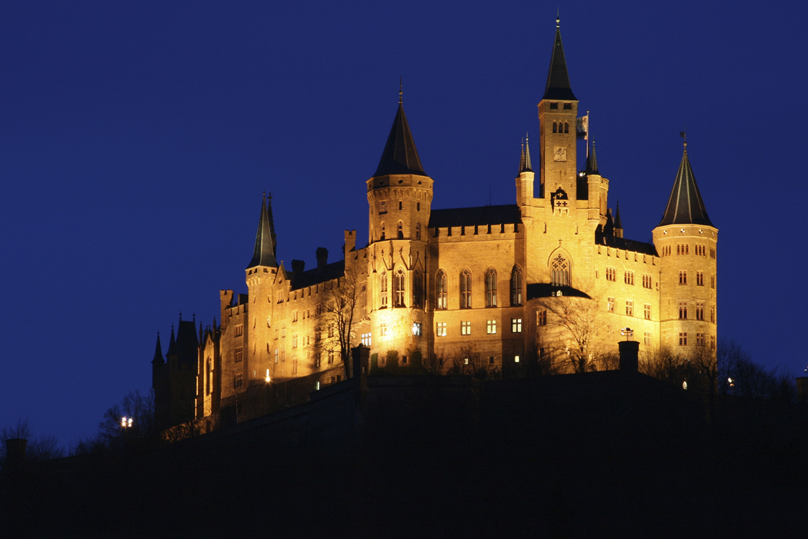
Question 19
When Juliet talks of the word which “hath slain ten thousand Tybalts” she is referring to the word
A. confession
B. banished
C. poisoned
D. purified

Slide 57
sorry!
Try your luck again.

Slide 58
wow!
Good job.
You may continue….

Slide 59
Question 20
Escalus, Prince of Verona, admitted guilt by saying he should have:
A. been more forceful about the feud
B. made peace between Romeo and Tybalt
C. taken stronger steps to keep the lovers apart
D. married Juliet himself

Slide 60
oops!
Go back and try another answer.

Slide 61
Excellent!
Good job.
You may continue….

Slide 62

Question 21
Romeo is banished to
A. Verona
B. Florence
C. Barcelona
D. Mantua

Slide 63
sorry!
Try your luck again.

Slide 64
wow!
Good job.
You may continue….

Slide 65

Question 22
Capulet tells Juliet that if she doesn’t obey him, he will
A. put her in a convent
B. disown her
C. kill her
D. send her to Disneyworld

Slide 66
no!
Go back and try again.

Slide 67
excellent!
Good job.
You may continue….

Slide 68

Question 23
What kept Friar Lawrence from getting to the tomb in a timely manner?
A. he slept in
B. he couldn’t find his wallet
C. he kept tripping over headstones
D. his messenger was delayed

Slide 69
wrong!
Try another answer!

Slide 70
Well done!
Good job.
You may continue….

Slide 71
Question 24
What was Paris’ final request before dying?
A. to be cremated
B. to be buried with Tybalt
C. to be buried with Juliet
D. have a golden statue of him built

Slide 72
sorry!
Try your luck again.

Slide 73
CORRECT!
Good job.
Proceed to the last question

Slide 74
Question 25
What disturbance prompts the Prince to threaten the feuding Capulets and Montagues?
A. The killing of Lord Montague’s nephew
B. The theft of land from the Montagues
C. Romeo sneaking around the Capulet orchard
D. The servants of the feuding families engage in a brawl

Slide 75
oops!
Go back and try another answer.

Slide 76
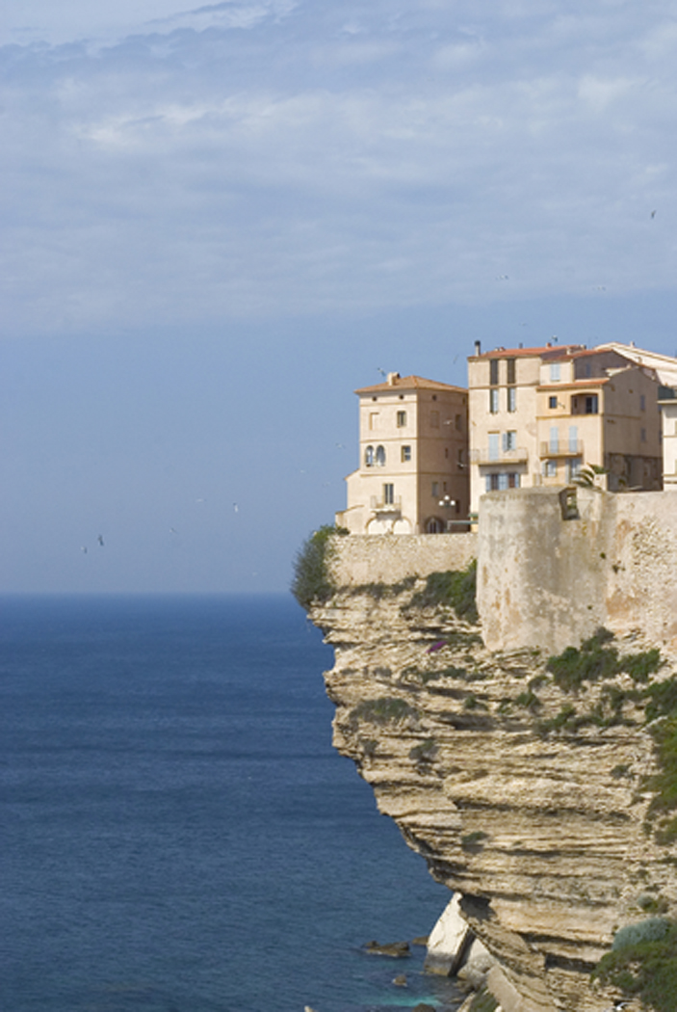
Game over

