Slide 1
A Raisin in the Sun
By Lorraine Hansberry

Slide 2
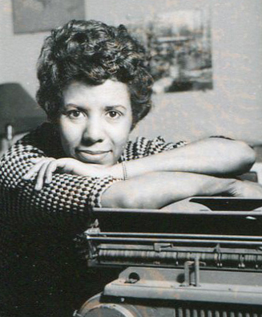
About Lorraine Hansberry (1932-1965)
She grew up in Chicago, attending a mostly white school. Her parents fought segregation.
Her parents moved to an all-white neighborhood; the discrimination they faced there resulted in a court case that her father took to the Supreme Court.
Both instances inspired Hansberry to write her play A Raisin in the Sun.

Slide 3
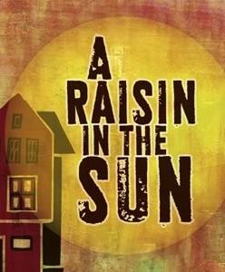
About the play
Published in 1959, just four years after Rosa Parks refused to give up her seat on the bus
The play captures the struggle for equality that African-Americans faced in the 1950s.
It touches on DREAMS, a common topic in African-American poetry, speeches, etc.

Slide 4
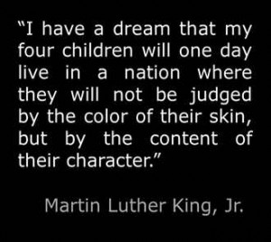
Sound familiar?
Langston Hughes’s “Harlem”
MLK’s “I Have a Dream Speech”
What happens to a dream deferred?
Does it dry up like a raisin in the sun?
Or fester like a sore, and then run?

Slide 5
Anyway, back to the play…
It was first performed in 1959.
It was the first play on Broadway ever to be produced by an African-American woman.
There have been several revivals of the play on Broadway; one of the most recent featured Sean (P. Diddy, Puff Daddy, Puffy, Diddy) Combs and Phylicia Rashad in 2004.
ABC produced a made-for-tv version in 2008 (and that is the version we will primarily watch in here).

Slide 6
Main Characters—The Youngers
Mama (Lena): head of the family, worries about her grown children
Walter Lee: the “man of the family” now that his father is dead (but he struggles with that position), feels defeated in life, struggles to be heard and acknowledged
Beneatha: Walter’s sister / Lena’s daughter, has big dreams of being a doctor

Slide 7
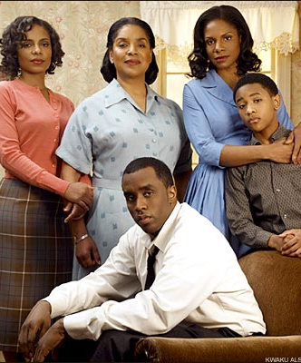
A couple more…
Ruth: Walter Lee’s wife, seems a bit hardened by the struggles of life, struggles to be a supportive wife and mother
Travis: Walter and Ruth’s 11-year-old son, sweet and clever, good kid, mischievous at times

Slide 8
Symbols & Allusions
The check—what does it represent?
The plant—Mama repeatedly tends to it. Maybe it represents something…
Title is an allusion to Langston Hughes’s “Harlem.”

