Slide 1
Native American Literature
Before mid-1500s

Slide 2
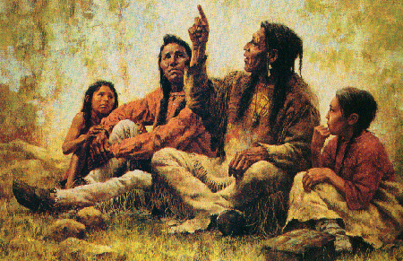
Native American Literature
The Native Americans passed down stories through oral tradition (word of mouth).

Slide 3
The Cycle
The early Native Americans believed in the cyclical nature of existence.
Examples: (seasons, circle of life, etc.)

Slide 4
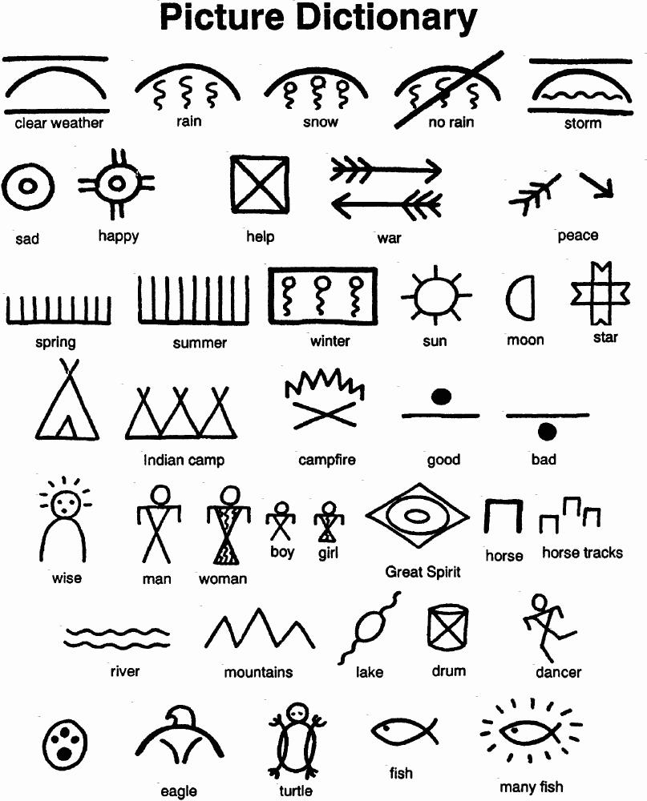
Other forms of communication
While Native Americans did not have a sophisticated system of writing, many tribes used symbolic drawings known as pictographs to communicate stories as well.

Slide 5
Traits of Native American Literature
Native American stories often convey practical information about the natural world and teach moral lessons
Animals and humans often interact with one another (including having actual conversations).
Stories/chants were believed to have certain powers to make things happen. (rain, successful hunt, etc.)

Slide 6
ARCHETYPES
Native American Literature is also known for its archetypes.
Archetypes are old imaginative patterns that appear across cultures and are repeated through the ages. They can be characters, plots, or images.

Slide 7
EXAMPLES OF ARCHETYPES
CHARACTERS
The evil villain
The helpless victim
The hero
The goofball
IMAGES
Nature as “mother” (“Mother Nature”
Tree as life giver
City as “The Promised Land”
PLOTS
Boy gets the girl
The hero faces the enemy and wins
The “underdog” team wins the game

Slide 8
With a partner….
Identify ARCHETYPES that you see in this story (can be character, plot, image, etc.)
Determine how the Iroquois view nature (animals, the earth, etc.) AND support your opinion with evidence. Find at least two examples.
Determine what similarities between this and other stories you may know. (Creation stories, maybe something else?)

Slide 9
With your partner…
Explain the meaning of this statement: “These two brothers, as they grew up, represented two ways of the world which are in all people” (38).

